Slide 1
0-1回归

Slide 2
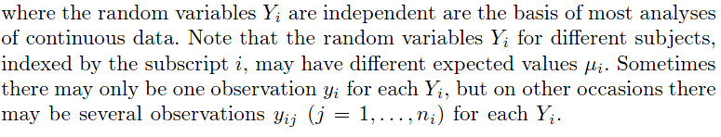
Exponential Family and Generalized Linear Models
Normal Linear Models:

Slide 3
Response variables have distributions other than the Normal distribution—they may even be categorical rather than continuous.
Relationship between the response and explanatory variables need not be of the simple linear form.

Slide 4
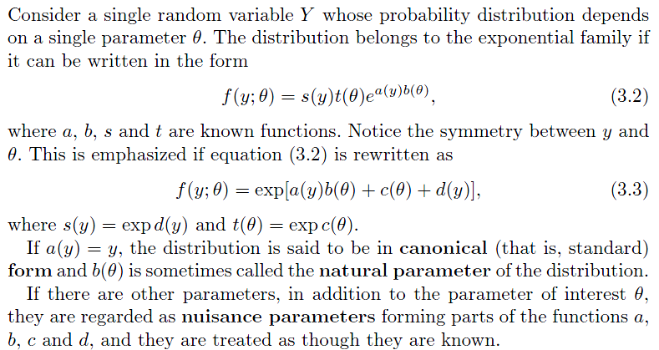
Exponential Family

Slide 5
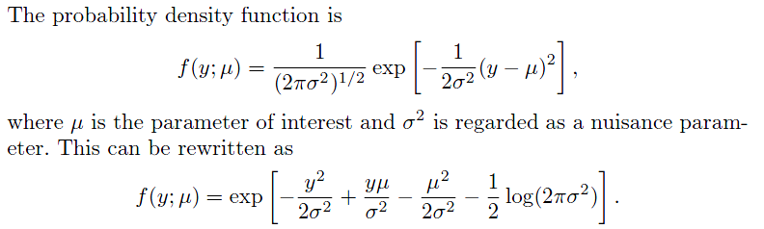
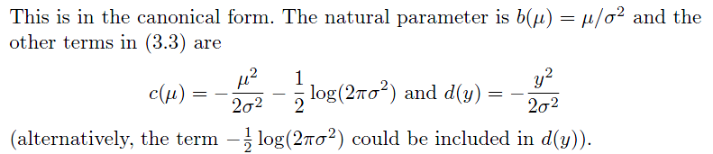
Normal distribution

Slide 6
The Normal distribution is used to model continuous data that have a symmetric distribution. It is widely used for three main reasons.
Many naturally occurring phenomena are well described by the Normal distribution; for example, height or blood pressure of people.
Even if data are not Normally distributed (e.g., if their distribution is skewed) the average or total of a random sample of values will be approximately Normally distributed; this result is proved in the Central Limit Theorem.
If continuous data y are not Normally distributed it is often worthwhile trying to identify a transformation, such as,y′ = log y or y′ = ′ that are approximately Normal.

Slide 7


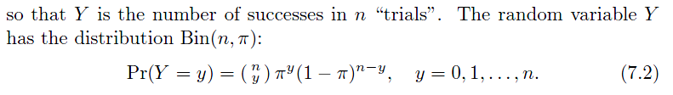
Binomial distribution
Binary random variable
with probabilities Pr(Z = 1) = π and Pr(Z = 0) = 1 − π, which is the Bernoulli distribution B(π).
If there are n such random variables Z₁, . . . ,Z_{n}, which are independent with Pr(Z_{j} = 1) = π, we define:

Slide 8
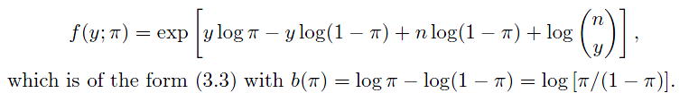
The Binomial distribution is usually the model of first choice for observations of a process with binary outcomes. Examples include the number of candidates who pass a test (the possible outcomes for each candidate being to pass or to fail) or the number of patients with some disease who are alive at a specified time since diagnosis (the possible outcomes being survival or death).

Slide 9
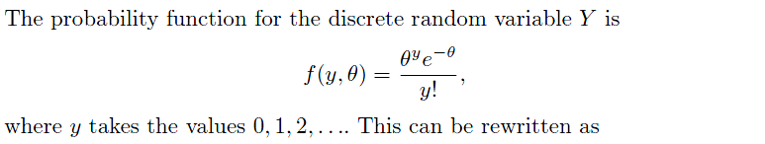
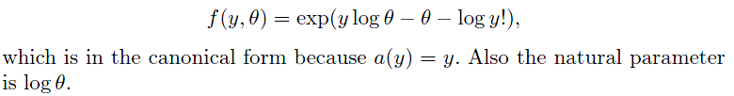
Poisson distribution

Slide 10
The Poisson distribution, denoted by Y ∼ Poisson(θ), is used to model count data. Typically these are the number of occurrences of some event in a defined time period or space, when the probability of an event occurring in a very small time (or space) is low and the events occur independently.
Examples include the number of medical conditions reported by a person, the number of tropical cyclones during a season, the number of spelling mistakes on the page of a newspaper, or the number of faulty components in a computer or in a batch of manufactured items.
If a random variable has the Poisson distribution, its expected value and variance are equal.

Slide 11
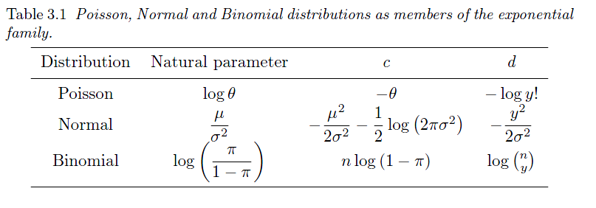

Slide 12
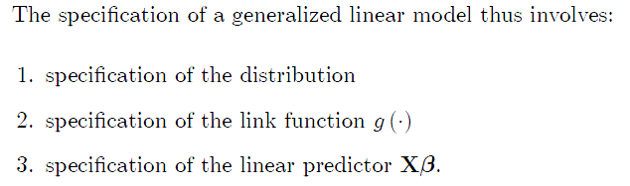
Generalized linear models

Slide 13
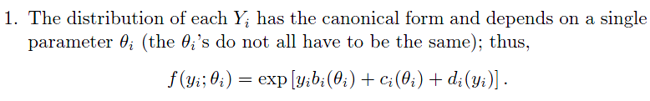
Generalized linear models
This model is defined in terms of a set of independent random variables Y₁, . . . , Y_{N}, each with a distribution from the exponential family and the following properties:

Slide 14
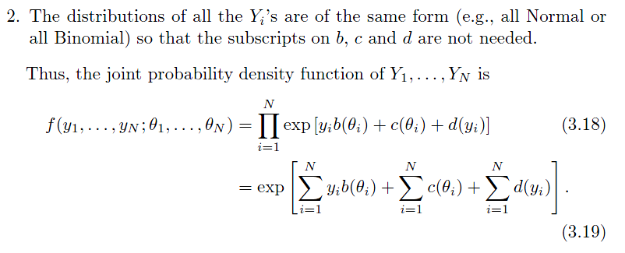

Slide 15
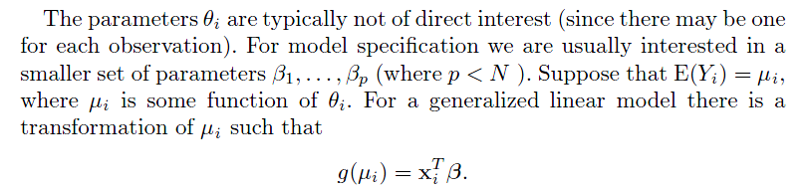


Slide 16

Normal Linear Model
Link function:

Slide 17
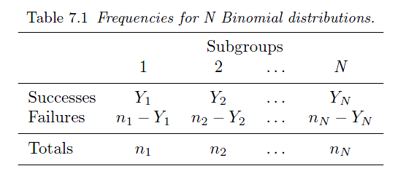

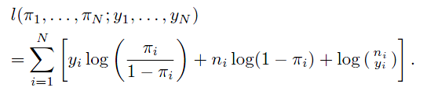
Logistic Regression

Slide 18


Logistic regression
We are interested in the proportion of successes:
We have
We model the probabilities π_{i} as

Slide 19
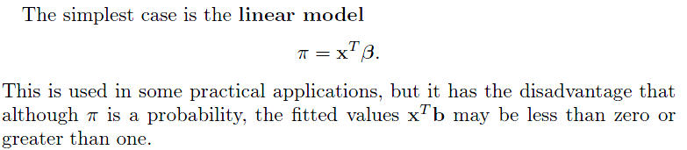

Slide 20

Logistic regression
Link function:
Hence
Odds of success

Slide 21
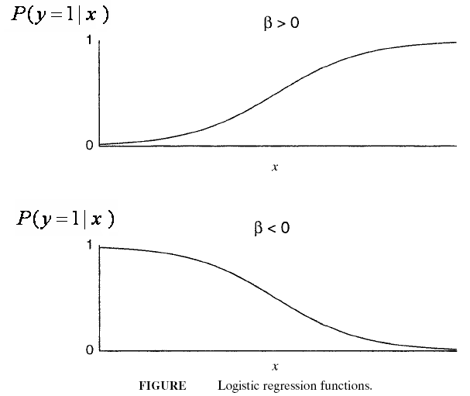

Slide 22
Other links
The probit link
The complementary log-log link

Slide 23
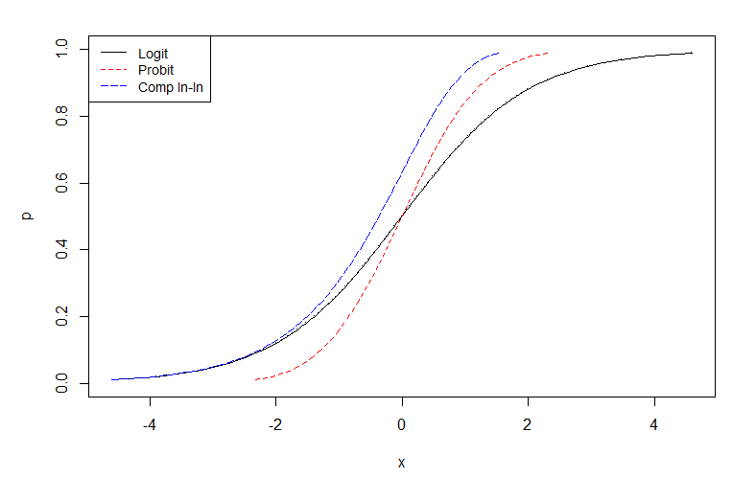
Comparison of probit, logit and complementary log-log links

Slide 24
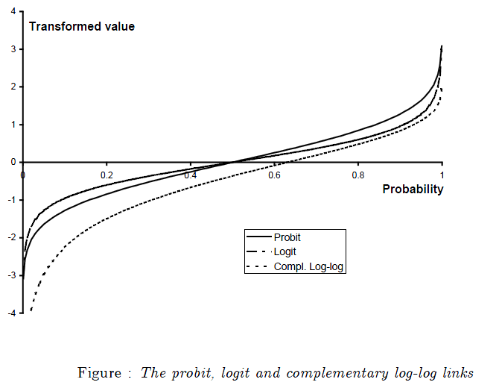
The logit and probit links are very similar.
As opposed to the probit and logit links, the complementary log-log link function is asymmetric around 0.
Complementary log-log works best with extremely skewed distributions .

Slide 25
Logit is Considered the Default Link
Advantages of Logit link function:
Leads to simpler mathematics
It is easier to interpret (Log odds)

Slide 26
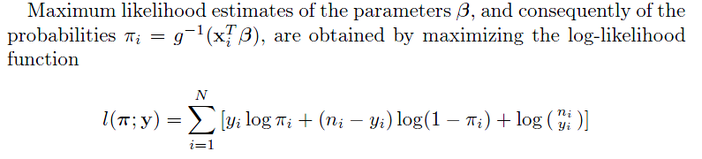
Estimation
That is, based on log-likelihood function, β can be estimated as MLE, with in the log-likelihood function .

Slide 27
Deviance: A goodness of fit statistic

Slide 28
Deviance for model comparison
For nested two models,

Slide 29
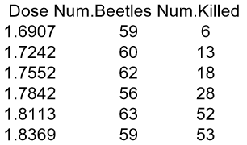
Example 1
A researcher is examining beetle mortality after 5 hours of exposure to carbon disulphide, at various levels of concentration of the gas.
Beetles were exposed to gaseous carbon disulphide at various concentrations (in mg/L) for five hours (Bliss, 1935) and the number of beetles killed were noted.

Slide 30
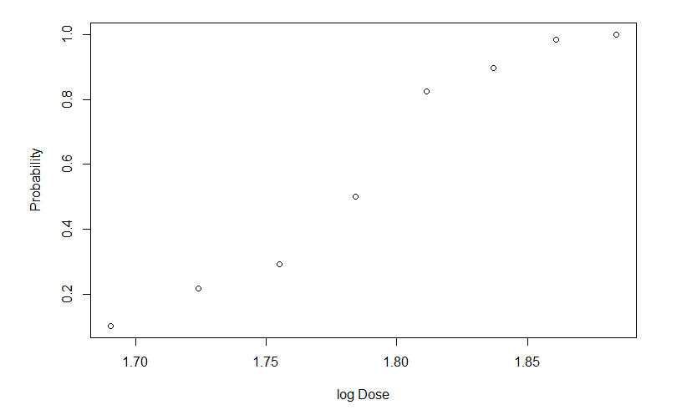
Plot the data first

Slide 31


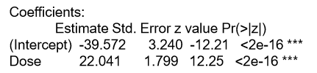
Logit model
Probit model
Complementary log-log model

Slide 32
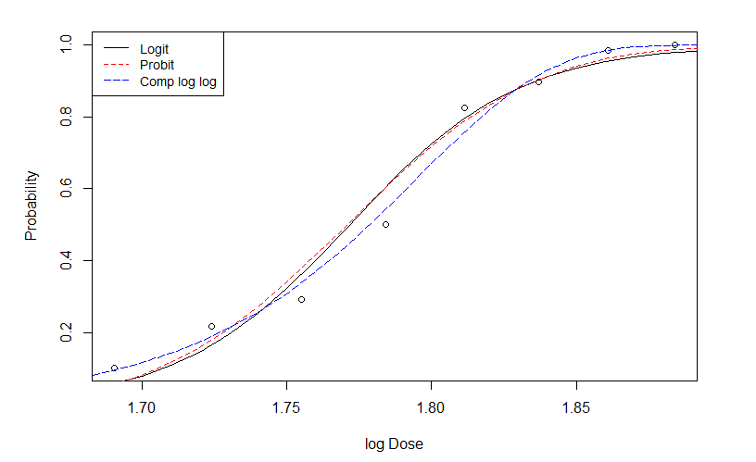

Slide 33
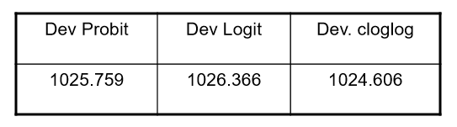
Deviance comparison of three models

Slide 34
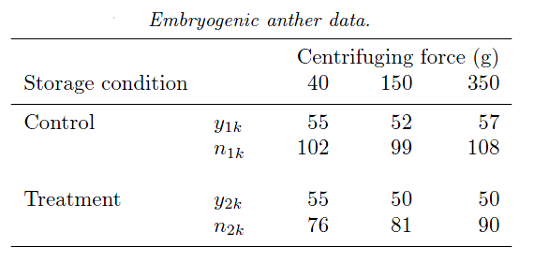
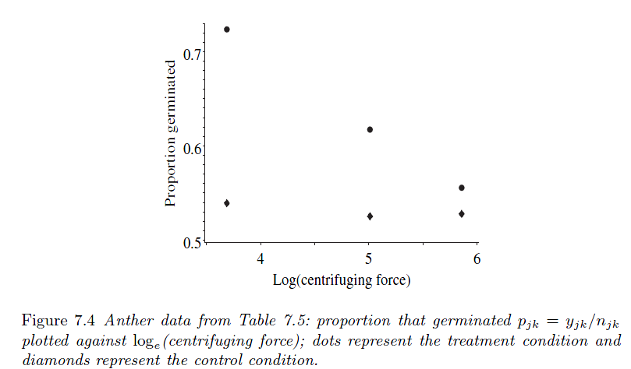
Example 2

Slide 35

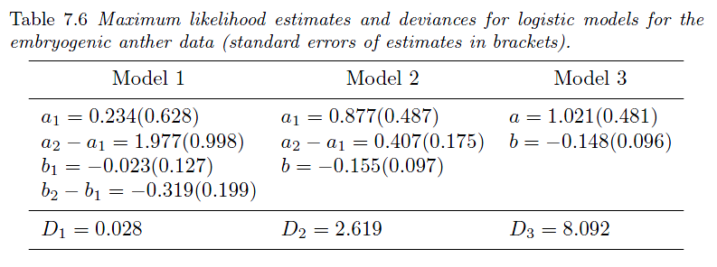
We will compare three logistic models, let j = 1 for the control group and j = 2 for the treatment group
Fitting Results:

Slide 36
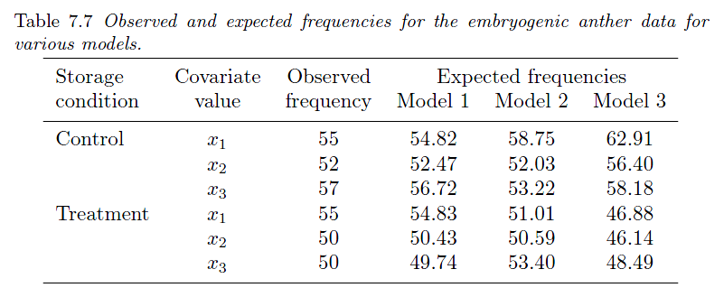

Slide 37
Pseudo R square
Sometimes the log-likelihood function for the fitted model is compared with the log-likelihood function for a minimal model, in which the values π_{i} are all equal.
Under the minimal model,
By analogy with R² for linear regression,
Which represents the proportional improvement in the log-likelihood function due to the terms in the model of interest, compared with the minimal model.

Slide 38
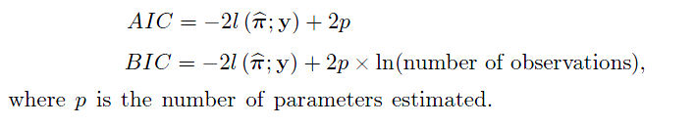
Other goodness of fit statistics: AIC and BIC
AIC and BIC are other goodness of fit statistics based on the log-likelihood function with adjustment for the number of parameters estimated and for the amount of data.
The model with the smaller value of AIC or BIC would be preferred.

Slide 39
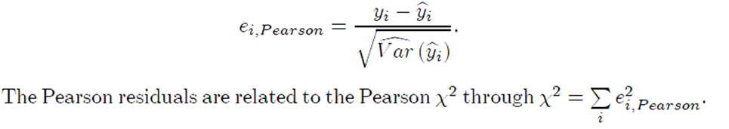
Diagnostic: residuals
In general linear models, a residual is the difference between the observed value of y and the fitted value .
Pearson residual:
In a binomial model,

Slide 40
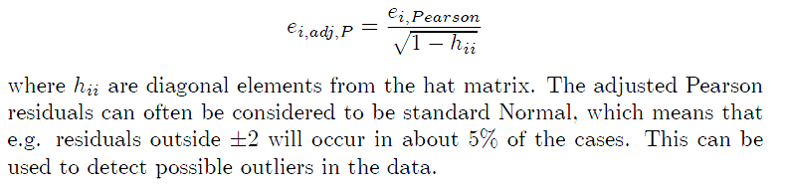
Standardized Pearson residual:

Slide 41

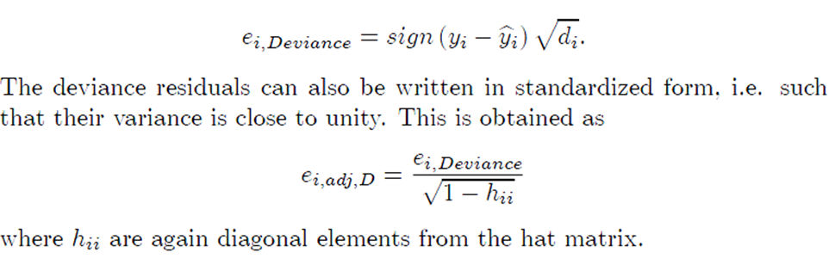
Deviance residuals
Remember
We define the deviance residuals as

Slide 42
Residual plot
A plot of residuals against the fitted values
A plot of residuals against covariates
should show a pattern where the residuals have a constant mean value of 0 and a constant range. Deviations from this “random” pattern may arise because of incorrect link function; omission of non-linear terms in the linear predictor and etc.
Plotting the residuals in the order the observations are given in the data may help to detect possible dependence between observations.
A normal probability plot of the residuals plots the sorted residuals against their expected values.

Slide 43
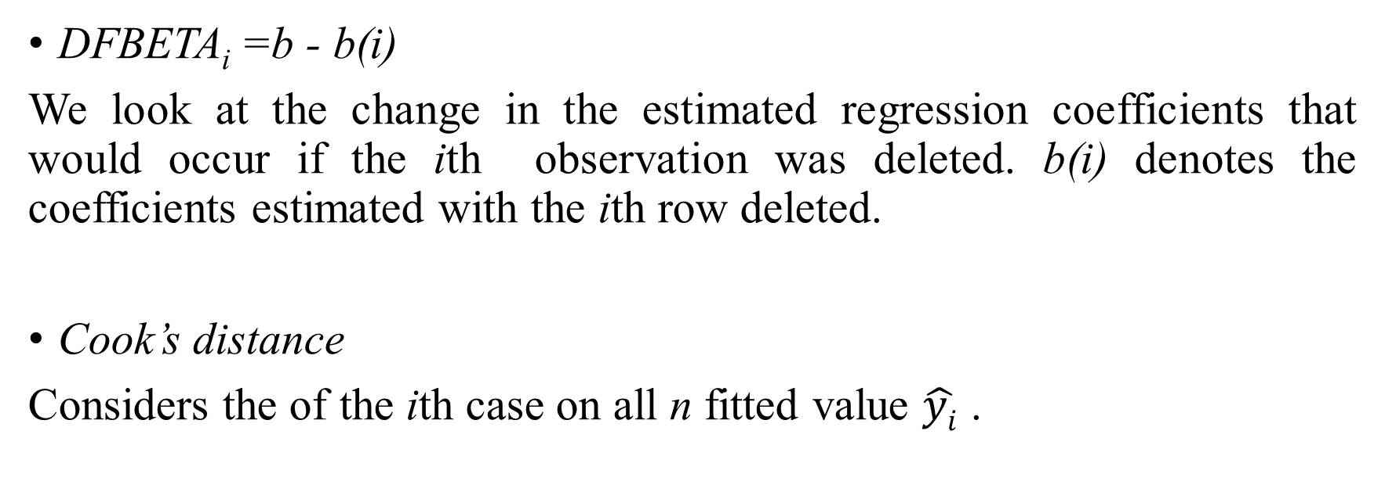
Detecting influential observations
DFBETA_{i}=b - b(i)
We look at the change in the estimated regression coefficients that would occur if the ith observation was deleted. b(i) denotes the coefficients estimated with the ith row deleted.
Cook’s distance
Considers the of the ith case on all n fitted value $\hat{yi}$ .

Slide 44
In my opinion, it is almost never a waste of time to inspect a plot of Cook's distance.
If influential observations are present, it may or may not be appropriate to change the model, but you should at least understand why some observations are so influential.
VIF is a function of X alone, and therefore how VIF is calculated and what it means is essentially equivalent to the linear regression case.
VIF: Variance inflation factors

Slide 45
Overdispersion in binary/binomial models
Overdispersion means that the variance of the response is larger than would be expected for the chosen model.
For binomial models, the variance of y_{i} =“number of successes” is nπ_{i} (1 − π_{i} ).
The variance of y_{i} /n_{i} is π_{i} (1−π_{i})/n_{i} .

Slide 46
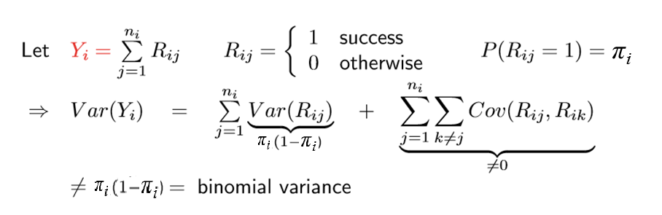

Slide 47
A common source of over-dispersion is that the data display some form of clustering. For example, different batches of animals may come from different parents, and thus be genetically different.
The observations are not independent.
A value of the Deviance/df statistic appreciably above unity may indicate that overdispersion is present in the data.

Slide 48

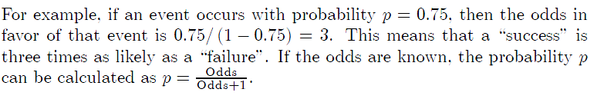
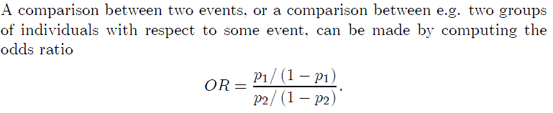
Inference: Odds ratio
Odds
Odds ratio

Slide 49
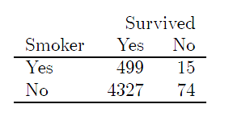
Example 3
Freeman (1989) reports on a study designed to assess the relation between smoking and survival of newborn babies. 4915 babies to young mothers were followed during their first year. For each baby it was recorded whether the mother smoked and whether the baby survived the first year.

Slide 50
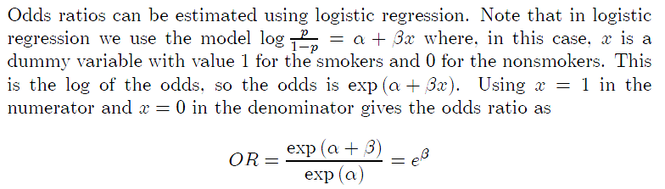
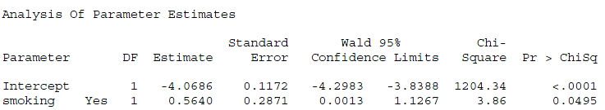

Estimates from logistic model

